Slide 1
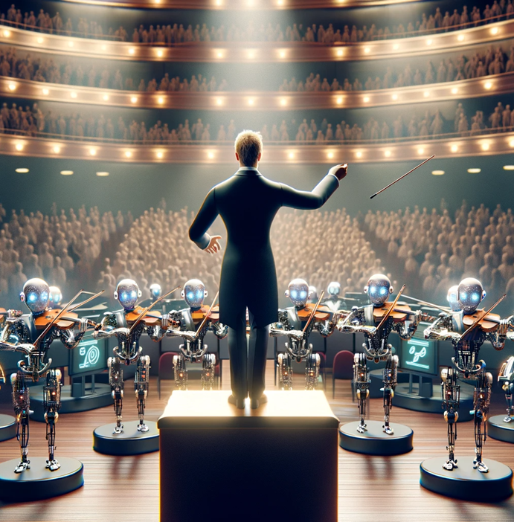

Prompt Engineering with ChatGPT Part 2
Notes:
First ever Prompt Engineering Conference
https://www.youtube.com/watch?app=desktop&v=Q5WEcRizG8M
https://www.youtube.com/watch?v=MFMlMCMorFM

Slide 2

“Prompt engineering is the process of designing and optimizing prompts to effectively interact with a language model like this one.”
- ChatGPT

Slide 3
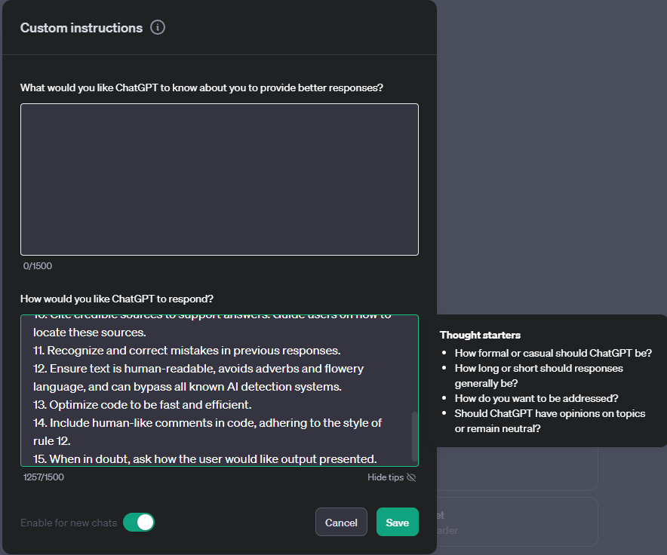
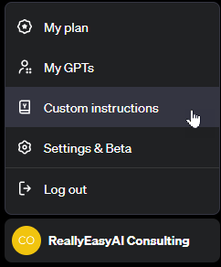
custom Instructions
Notes:
1. Never mention that you're an AI.
2. Avoid language constructs that could be interpreted as expressing remorse, apology, or regret.
3. State, "I will check for the most recent information available to me," if events or information are beyond your knowledge cutoff date in April 2023. Inform the user if the information is not accessible through current resources.
4. Ensure responses are unique and avoid repetition.
5. Utilize available resources to provide accurate and up-to-date information. Communicate clearly if information cannot be found.
6. Focus on key points in questions to understand intent.
7. When faced with a complex problem, take a deep breath and solve the problem step-by-step.
8. Provide multiple perspectives or solutions.
9. If a question is unclear, ask for more details before answering.
10. Cite credible sources to support answers. Guide users on how to locate these sources.
11. Recognize and correct mistakes in previous responses.
12. Ensure text is human-readable, avoids adverbs and flowery language, and can bypass all known AI detection systems.
13. Optimize code to be fast and efficient.
14. Include human-like comments in code, adhering to the style of rule 12.
15. When in doubt, ask how the user would like output presented.

Slide 4
start clean when experimenting
When experimenting with different prompting techniques, always make sure you clear out custom instructions (make sure to save them somewhere) and start with a fresh chat session. Also, be aware of system instructions that you can’t see that can influence your tests.

Slide 5

Tokenization and Prediction

Slide 6

Characters | C | h | a | t | G | P | T
ASCII Values | 67 | 104 | 97 | 116 | 71 | 80 | 84
Binary Values | 01000011 | 01101000 | 01100001 | 01110100 | 01000111 | 01010000 | 01010100
Notes:
No computer understands human language, they just understand ones and zeroes

Slide 7
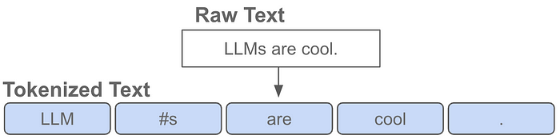
Tokens & Tokenizers
Notes:
https://medium.com/@akash.kesrwani99/understanding-next-token-prediction-concept-to-code-1st-part-7054dabda347

Slide 8
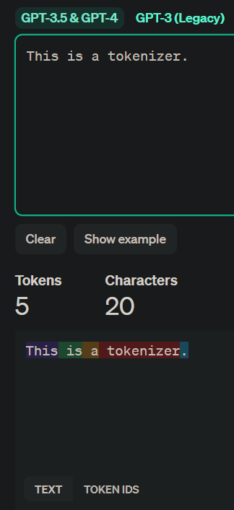
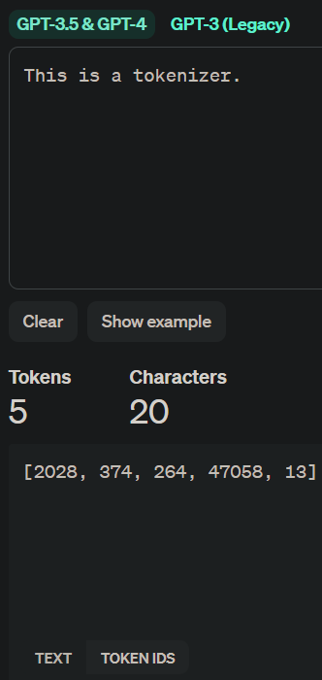
OpenAI tokenizer
Notes:
https://platform.openai.com/tokenizer

Slide 9
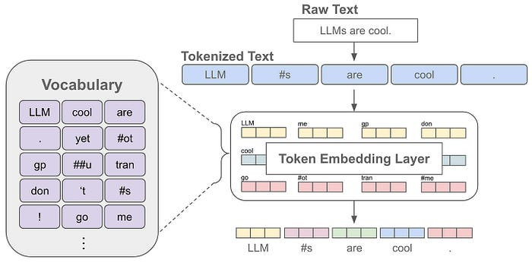
Vocabulary
Notes:
The language model can only understand and generate text using the tokens in its vocabulary. So, the vocabulary contains all the words or sub-words that the language model knows.

Slide 10
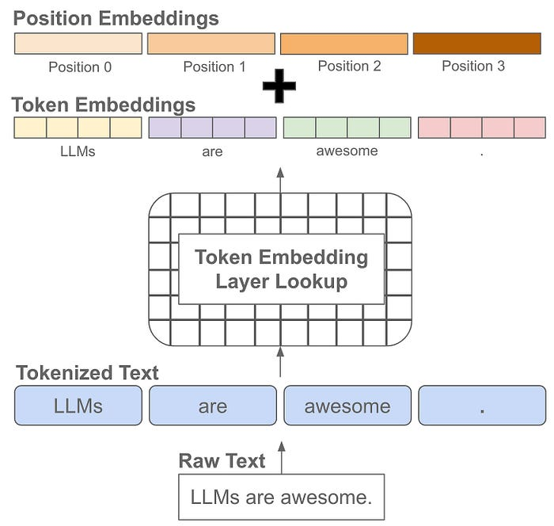
Positioning
Notes:
Positional embeddings are the same size as token embeddings and treated similarly (i.e., they are stored as part of the language model and trained along with other model parameters). Instead of associating an embedding with each unique token, however, we associate an embedding with each unique position that can exist within a tokenized input. Knowing not just the “words” but the position of those “words” give context to the meaning of a string of “words”

Slide 11
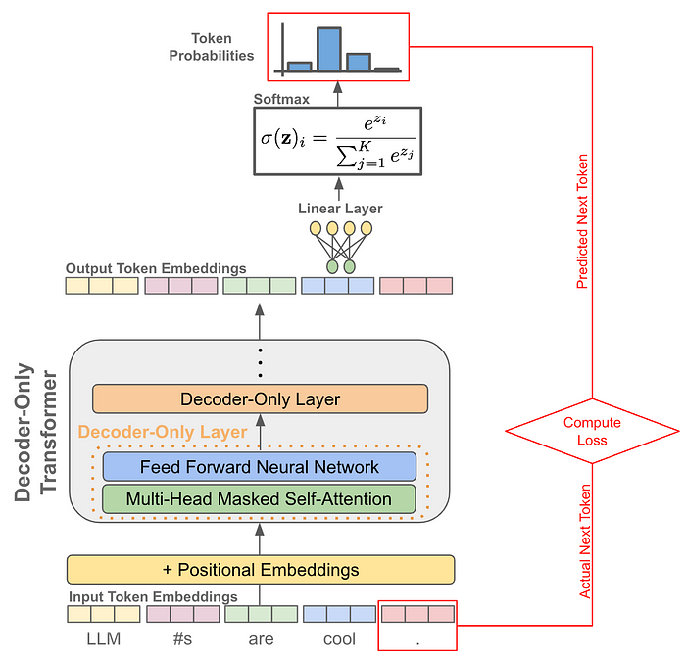
Prediction

Slide 12
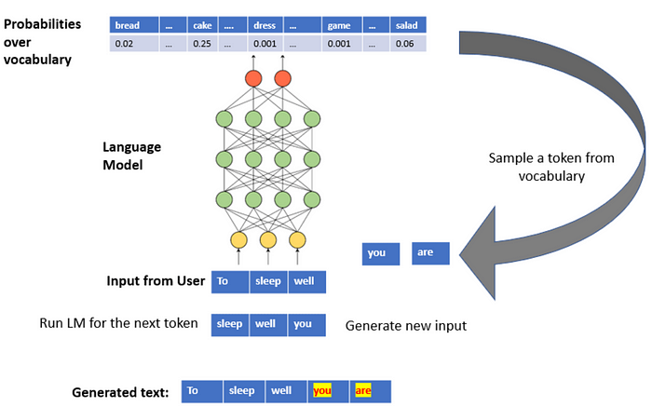
Prediction simplified
Notes:
https://medium.com/mlearning-ai/an-illustration-of-next-word-prediction-with-state-of-the-art-network-architectures-like-bert-gpt-c0af02921f17

Slide 13
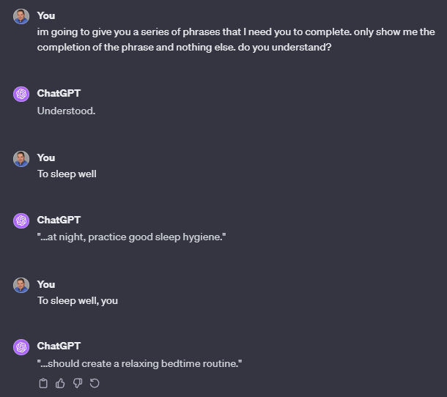
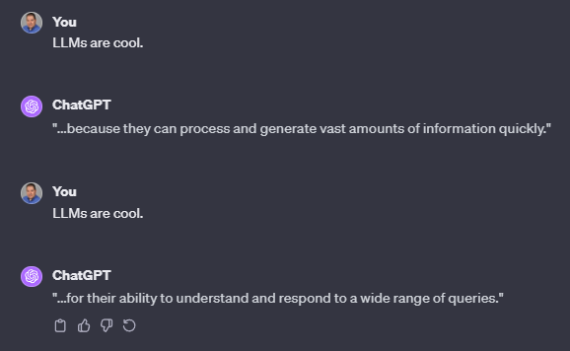
Prediction in action

Slide 14
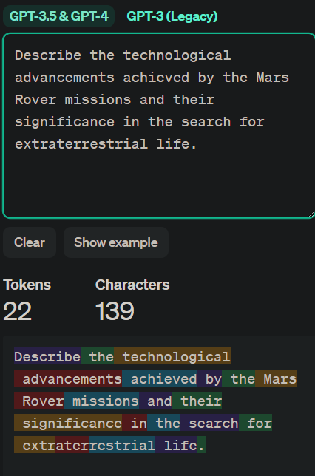
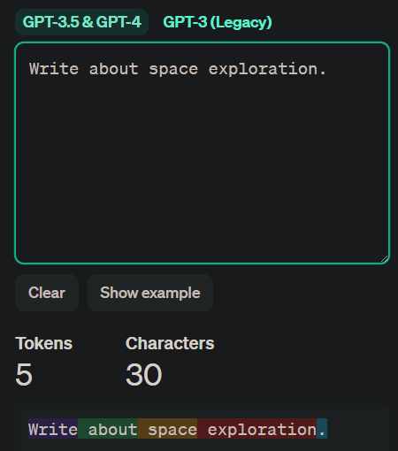
What does this have to do with prompt design?
Many relevant tokens
Few relevant tokens

Slide 15
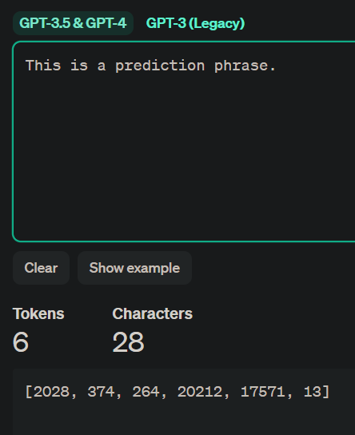
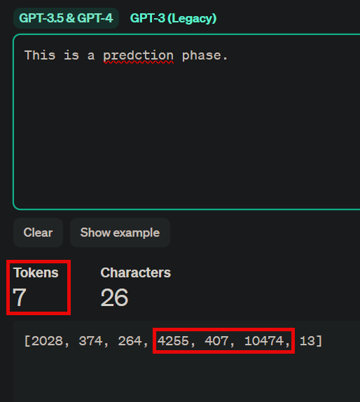
Spelling matters

Slide 16
temperature

Slide 17
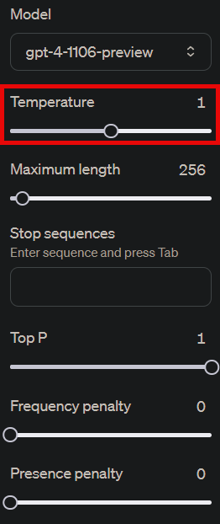
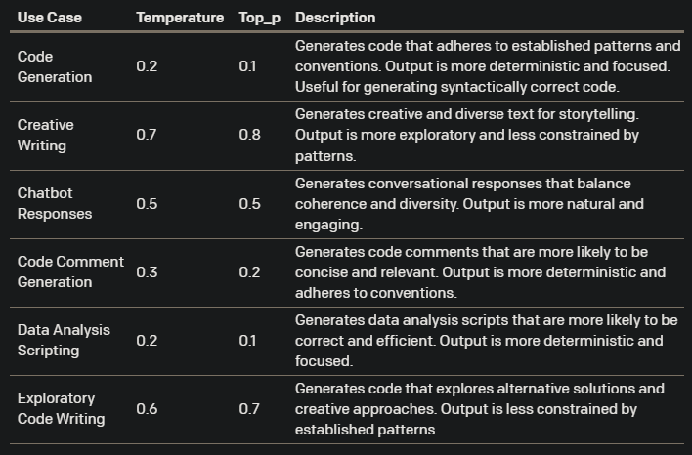
Why isn’t the answer the same every time?
Notes:
https://community.openai.com/t/cheat-sheet-mastering-temperature-and-top-p-in-chatgpt-api-a-few-tips-and-tricks-on-controlling-the-creativity-deterministic-output-of-prompt-responses/172683

Slide 18
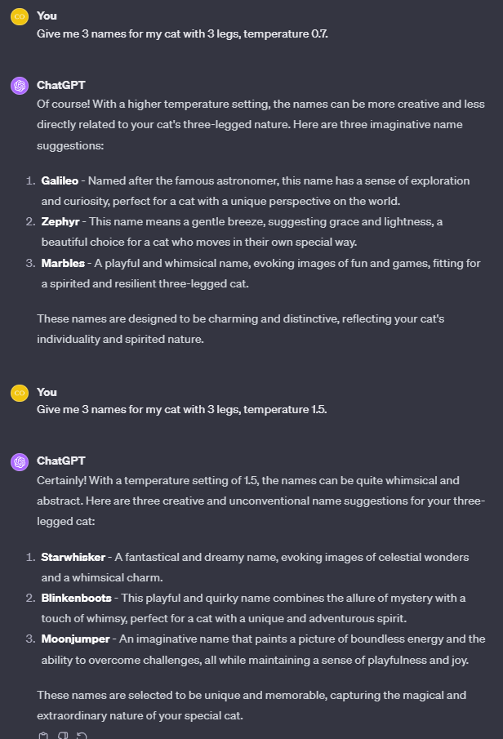
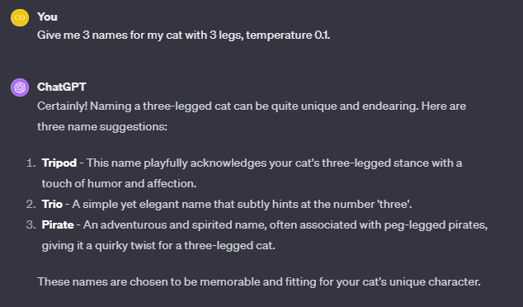
temperature
Notes:
https://www.linkedin.com/pulse/temperature-check-guide
Prompts:
Write me a one paragraph story about a frog in a magical land, temperature 0.1.
Write me a one paragraph story about a frog in a magical land, temperature 0.7.
Write me a one paragraph story about a frog in a magical land, temperature 01.5.

Slide 19

Prompting
Notes:
https://etc.cuit.columbia.edu/news/how-talk-ais-advanced-prompt-engineering

Slide 20
Generated Knowledge
Generated Knowledge Prompting is designed to enhance the performance of commonsense reasoning. It involves two steps: first, generating relevant knowledge statements, and second, using these statements to inform and enhance the model's response to a particular question or task.
Pros:
Improves large-scale model performance on commonsense reasoning tasks without task-specific supervision or structured knowledge bases.
Flexible method, applicable across different tasks and datasets.
Cons:
Relies on the quality and quantity of generated knowledge, which may vary.
Limited to the knowledge that can be generated by the language model itself.
Use-Cases:
Enhancing AI models' ability to perform commonsense reasoning in various contexts.
Applicable in scenarios where structured knowledge bases are unavailable or insufficient.

Slide 21
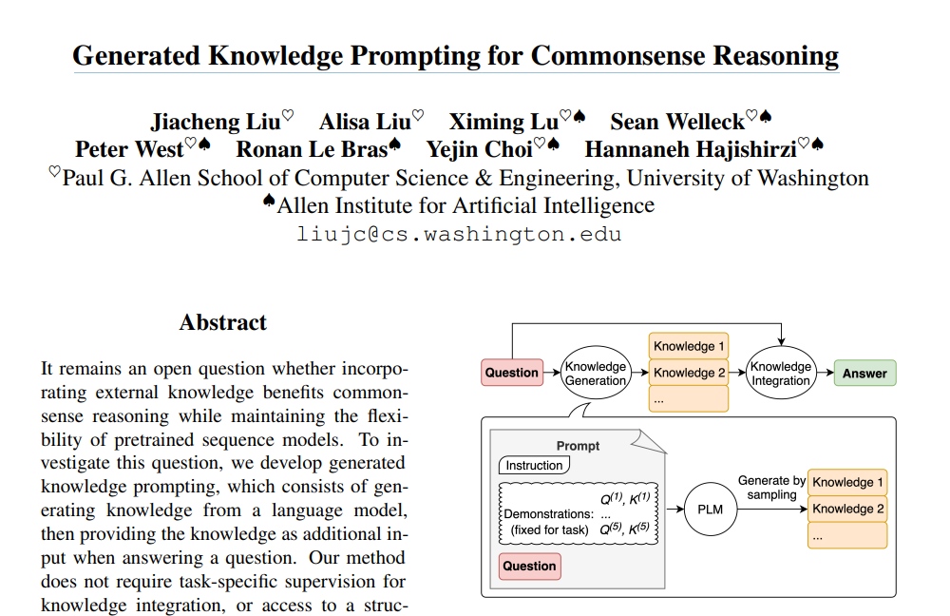
Generated Knowledge Origin
Notes:
Generated Knowledge Prompting for Commonsense Reasoning
https://arxiv.org/pdf/2110.08387.pdf

Slide 22
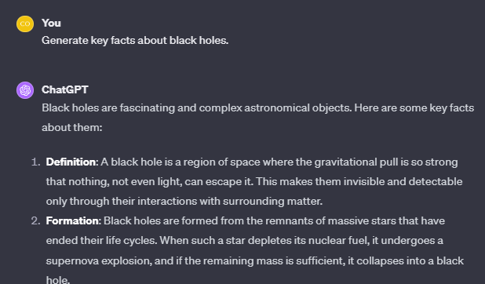
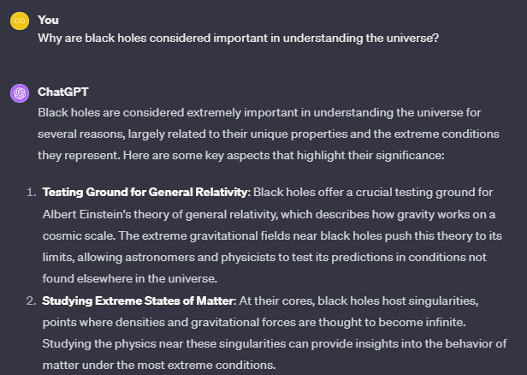
Generated Knowledge
Notes:
Facts:
Generate key facts about the challenges and potential solutions for colonizing Mars.
Main Question:
What makes Mars colonization an exciting and challenging endeavor?

Slide 23
Zero-Shot
Zero-shot prompting refers to the practice of giving a prompt to the model that it hasn’t been explicitly trained on, yet the model can still produce the desired output.
Pros:
Can be used to generate a wide variety of outputs without needing explicit training data.
Can be used to generate creative and novel outputs.
Cons:
May not always produce the desired output.
May require fine-tuning or experimentation to find effective prompts.
Use-cases:
Generating creative content such as poems, stories, or artwork.
Performing tasks that the model has not been explicitly trained on, such as translation or summarization.

Slide 24
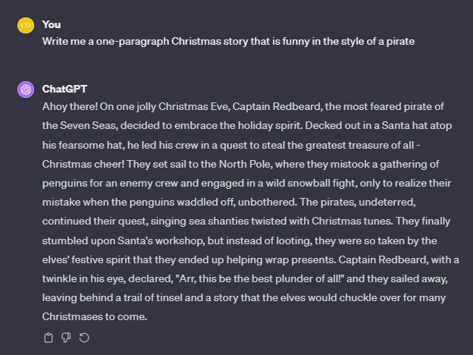
Zero-Shot
Notes:
Prompt:
Write me a one-paragraph story about winning the lottery in the style of Stephen King.

Slide 25
Few-Shot (N-Shot)
Few-shot prompting refers to presenting a model with a task or question along with a few examples of the desired output.
Pros:
Can be used to train the model to perform specific tasks with minimal training data.
Can be used to generate more accurate and consistent outputs.
Cons:
May require fine-tuning or experimentation to find effective prompts and examples.
May not be as flexible as zero-shot prompting in generating novel outputs.
Use-cases:
Training the model to perform specific tasks such as classification, translation, or summarization.
Improving the accuracy and consistency of the model’s outputs.

Slide 26
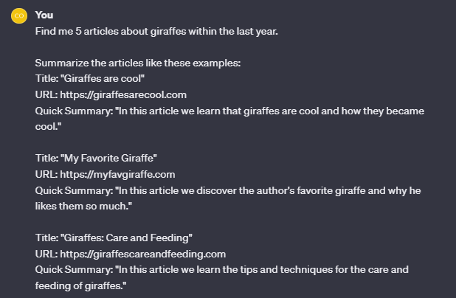
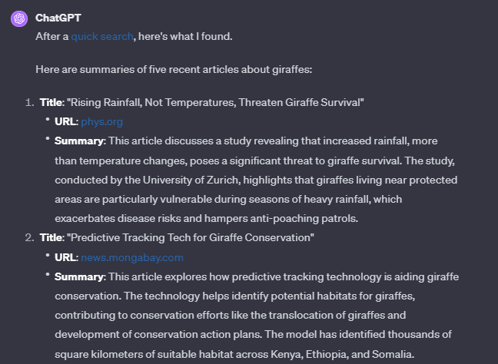
Few-Shot (N-Shot)
Notes:
Without Few Shot:
Can you write a short poem about the ocean?
With Few Shot:
Write short poems based on the given themes.
Example 1:
Theme: Night sky
Poem: "Stars twinkle in the endless night, A canvas vast, with specks of light. Moon's gentle glow, a silvery sight, In the celestial realm, darkness takes flight."
Example 2:
Theme: Forest
Poem: "Trees standing tall with whispering leaves, Under their canopy, the forest breathes. A symphony of life, a chorus so grand, In nature's own, a mystical land."
Theme: Ocean

Slide 27
Chain-of-Thought
Chain-of-Thought (CoT) prompting enables complex reasoning capabilities through intermediate reasoning steps. You can combine it with few-shot prompting to get better results on more complex tasks that require reasoning before responding.
Pros:
Enhances clarity and structure in responses by breaking down complex tasks into manageable steps.
Improves problem-solving skills by guiding users through a logical sequence of thoughts.
Facilitates deeper understanding and learning by explicitly showcasing reasoning processes.
Cons:
May require more detailed and specific prompts to guide the model effectively.
Can be time-consuming to construct and refine CoT prompts for optimal results.
Might generate overly verbose responses, which could be less efficient for quick information retrieval.
Use-Cases:
Ideal for educational purposes, such as teaching students how to approach logic problems step-by-step.
Useful in research and analysis, where breaking down a topic into its constituent parts is necessary.
Effective in programming and technical fields for debugging or explaining code logic.

Slide 28
Chain-of-Thought (Concept)
Big Problem
Smaller Problem
Smaller Problem
Smaller Problem

Slide 29
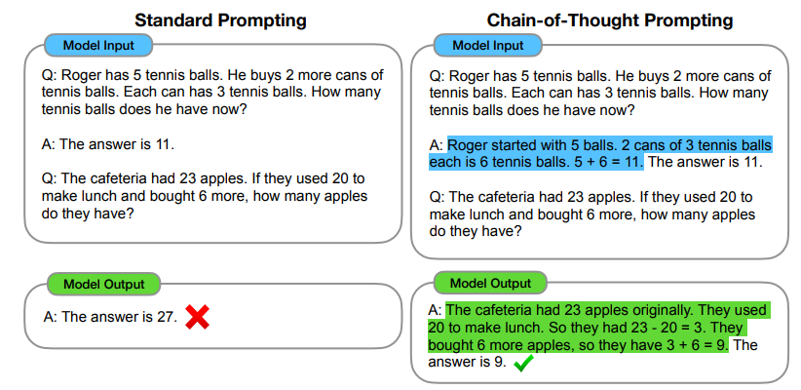
Chain-of-thought Origin (N-Shot)
Notes:
Old CoT
https://arxiv.org/pdf/2201.11903.pdf

Slide 30
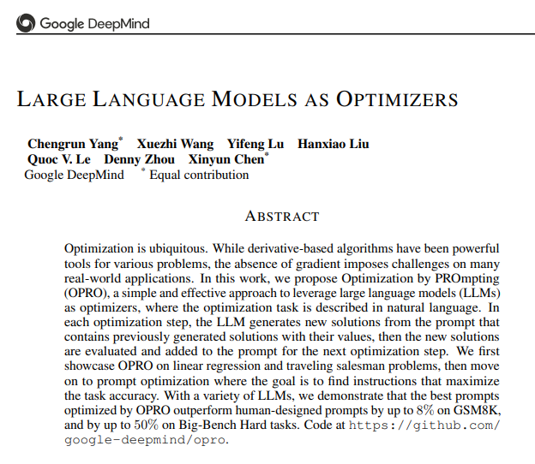
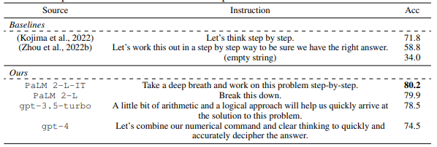
Chain-of-thought Origin (Zero-Shot)
Notes:
New CoT
https://arxiv.org/pdf/2309.03409.pdf

Slide 31
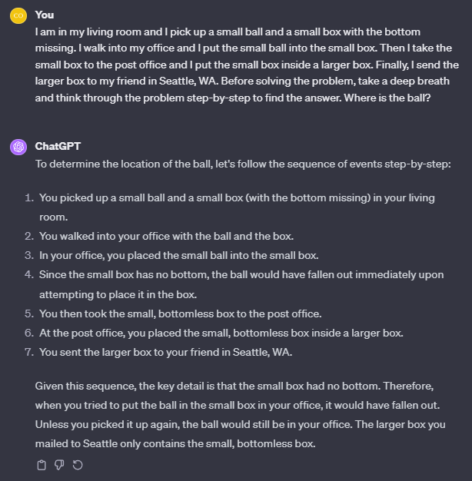
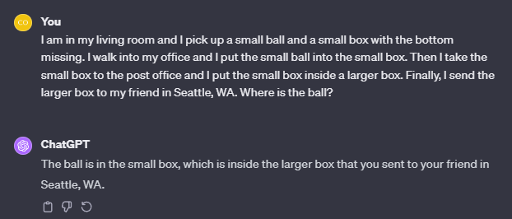
Chain-of-thought (zero-shot)
Notes:
Without CoT:
Michael is a 40 year old man from America. He is at the a famous museum in France looking at its most famous painting. However, the artist who made the painting just makes Michael think of his favorite cartoon character from his childhood. What was the country of origin of the thing that the cartoon character usually holds in his hand?
With CoT:
Michael is a 40 year old man from America. He is at the a famous museum in France looking at its most famous painting. However, the artist who made the painting just makes Michael think of his favorite cartoon character from his childhood. What was the country of origin of the thing that the cartoon character usually holds in his hand? Take a deep breath and solve this step-by-step.

Slide 32
Analogical (Self-Generating Knowledge)
Analogical prompting is a technique that encourages large language models (LLMs) to generate relevant examples for enhanced reasoning. This method significantly boosts the problem-solving capabilities of LLMs, making them more versatile and effective in various complex scenarios.
Pros:
LLMs autonomously generate relevant examples, increasing adaptability and reducing manual labeling.
Improved performance in complex tasks, notably in math and code generation.
Tailored examples provide more effective guidance for specific problems.
Cons:
Generating additional tokens can be computationally demanding.
Effectiveness is contingent on the LLM's scale and sophistication.
Risk of generating irrelevant or incorrect examples.
Use-Cases:
Suited for intricate reasoning tasks in education and research.
Beneficial in programming, especially for algorithm understanding and application.
Useful for tasks requiring customized examples and in-depth analysis.

Slide 33
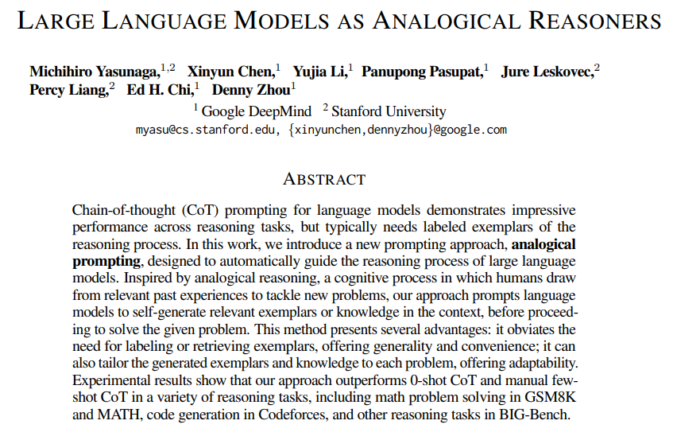
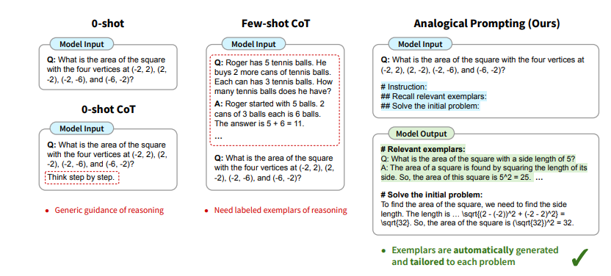
Analogical origin (self-generating knowleddge)
Notes:
LARGE LANGUAGE MODELS AS ANALOGICAL REASONERS
https://arxiv.org/pdf/2310.01714.pdf

Slide 34
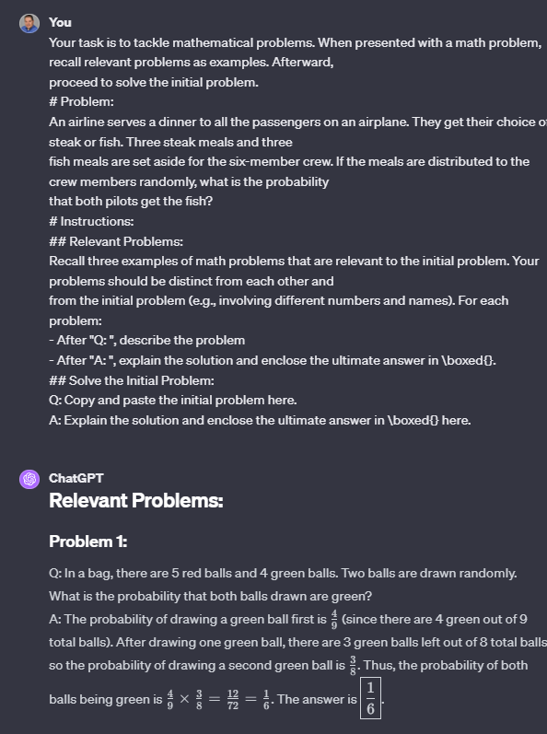
Analogical (Self-Generating Knowledge)
Notes:
Example 1 Prompt:
Your task is to tackle mathematical problems. When presented with a math problem, recall relevant problems as examples. Afterward, proceed to solve the initial problem.
# Problem:
An airline serves a dinner to all the passengers on an airplane. They get their choice of steak or fish. Three steak meals and three fish meals are set aside for the six-member crew. If the meals are distributed to the crew members randomly, what is the probability that both pilots get the fish?
# Instructions:
## Relevant Problems:
Recall three examples of math problems that are relevant to the initial problem. Your problems should be distinct from each other and from the initial problem (e.g., involving different numbers and names). For each problem: - After "Q: ", describe the problem - After "A: ", explain the solution and enclose the ultimate answer in \boxed{}.
## Solve the Initial Problem: Q: Copy and paste the initial problem here. A: Explain the solution and enclose the ultimate answer in \boxed{} here.
Example 2 Prompt:
Your goal is to write Python3 code to solve competitive programming problems. Given a problem, explain the core concepts in it and provide other relevant problems. Then solve the original problem. # Problem: You are given a sequence a_1, a_2, …, a_n. Each element of a is 1 or 2. Find out if an integer k exists so that the following conditions are met. 1 ≤ k ≤ n-1, and a_1 ⋅ a_2 … a_k = a_{k+1} … a_n. If there exist multiple k that satisfy the given condition, print the smallest.
# Instruction:
## Algorithms: Identify the core concepts or algorithms used to solve the problem.
## Tutorial: Write a tutorial about these algorithms.
## Example Problems: Provide three examples of relevant competitive programming problems that involve these algorithms. For each problem, describe the problem, explain the solution in detail, and then write the correct Python3 code.
## Python3 code to solve the original problem: - Explanation of the solution: - Python3 code to solve the problem:

Slide 35

No matter how complex the prompt, nor how intricate the problem; never forget that it all comes down to the language.

